Slide 1
Removing a Hyperparameter from VIME
Name: Allan Axelrod

Slide 2
Recall - Key Papers
Algorithm Paper
VIME: Variational Information Maximizing Exploration
Rein Houthooft, Xi Chen, Yan Duan, John Schulman, Filip De Turck, Pieter Abbeel
Measure Papers
Entropic Value-at-Risk: A New Coherent Risk Measure
Author
Amir Ahmadi-Javid
Portfolio Optimization with Entropic Value-at-Risk
Authors
Amir Ahmadi-Javid and Malihe Fallah-Tafti

Slide 3
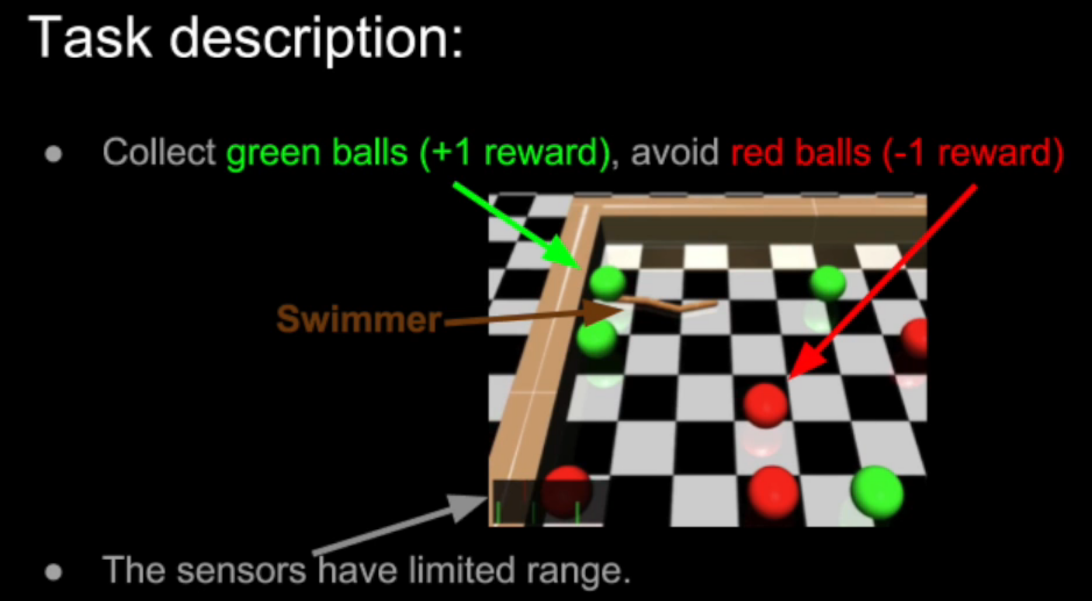
Swimmer Gather Domain

Slide 4
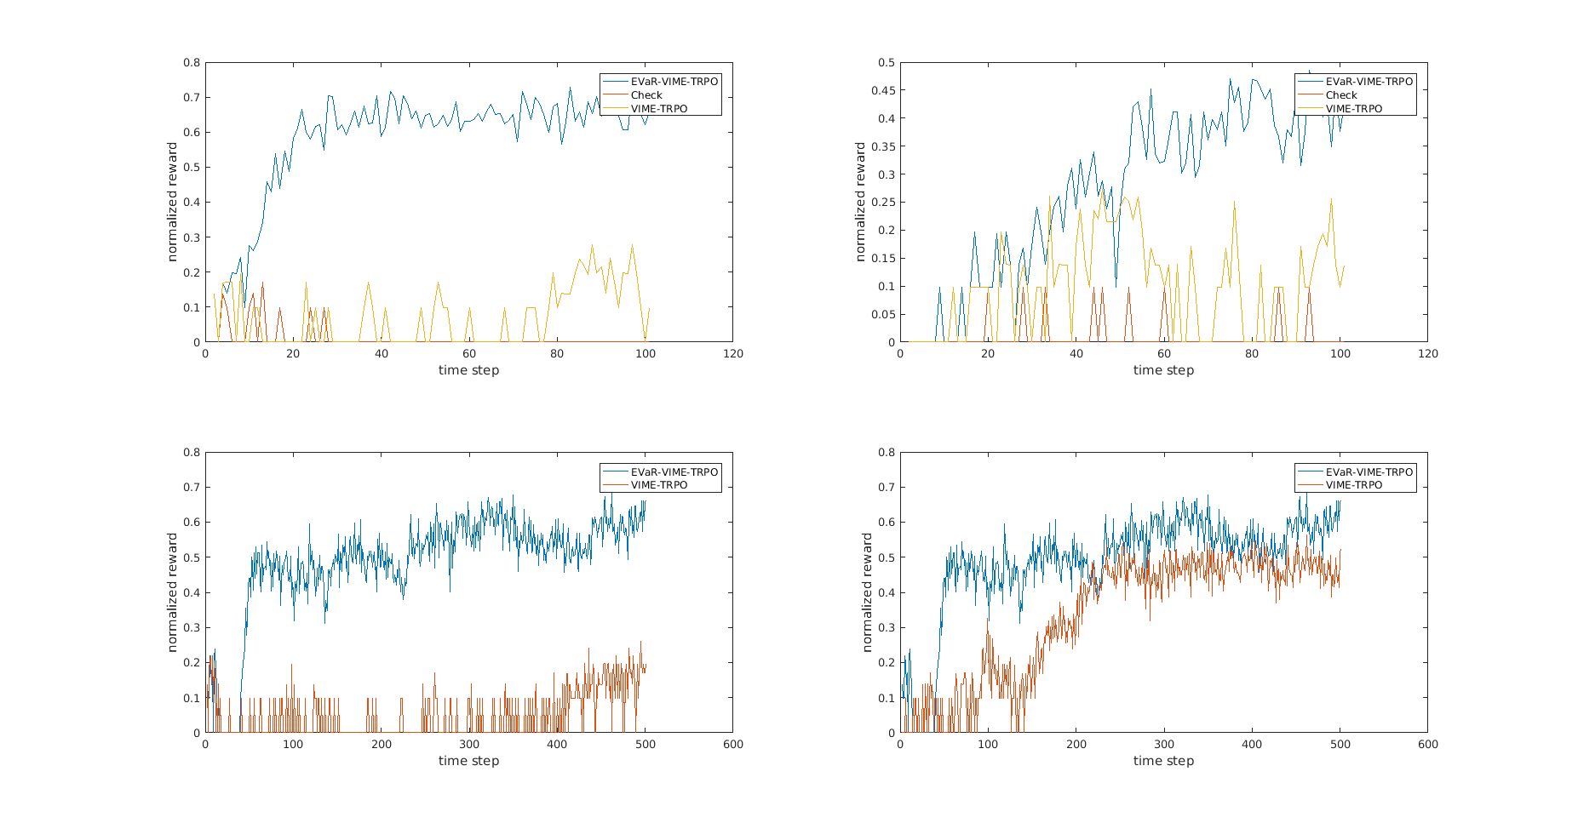
Empirical Results Obtained
VIME

Slide 5
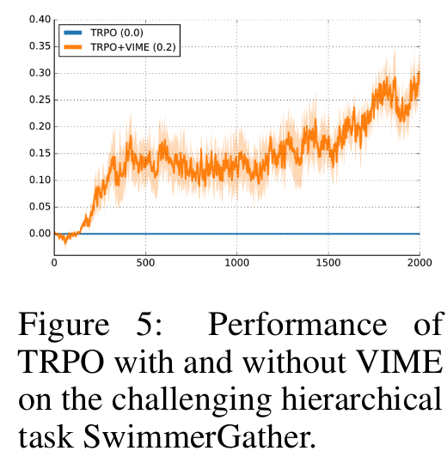
Empirical Results Obtained
VIME

Slide 6
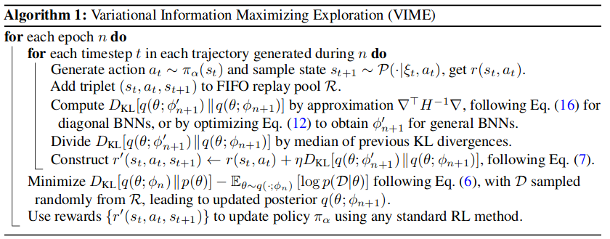
What Was Changed?
Key component
“Intrinsic Reward” of trajectory as an input RL methods

Slide 7
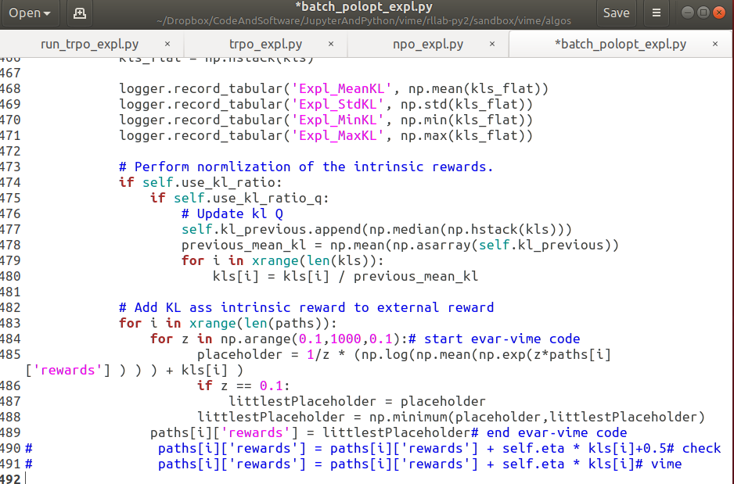
How Was it Changed?

Slide 8
Substituting Intrinsic Reward with Entropic Value at Risk
EVaR
Upper bounds “intrinsic reward” used in VIME for the same
Intrinsic Reward
EVaR
Q is known as the ‘risk neutral’ risk measure
Stop-Loss Ordering
Strong Monotonicity
Probabilistic Meaning of EVaR (by definition)

Slide 9
Future Work
Run experiments of greater duration and with more seeds
Used 2 seeds for 100 iteration experiments
Used 1ish seeds for 500 iteration experiments
Run experiment on other domains
Only used Swimmer Gather
Other domains necessary to demonstrate whether Swimmer Gather is just EVaR-friendly or if sample-based EVaR is useful for deep rl

